Slide 1

Closing Procedure
5.20.24 version 1.0

Slide 2
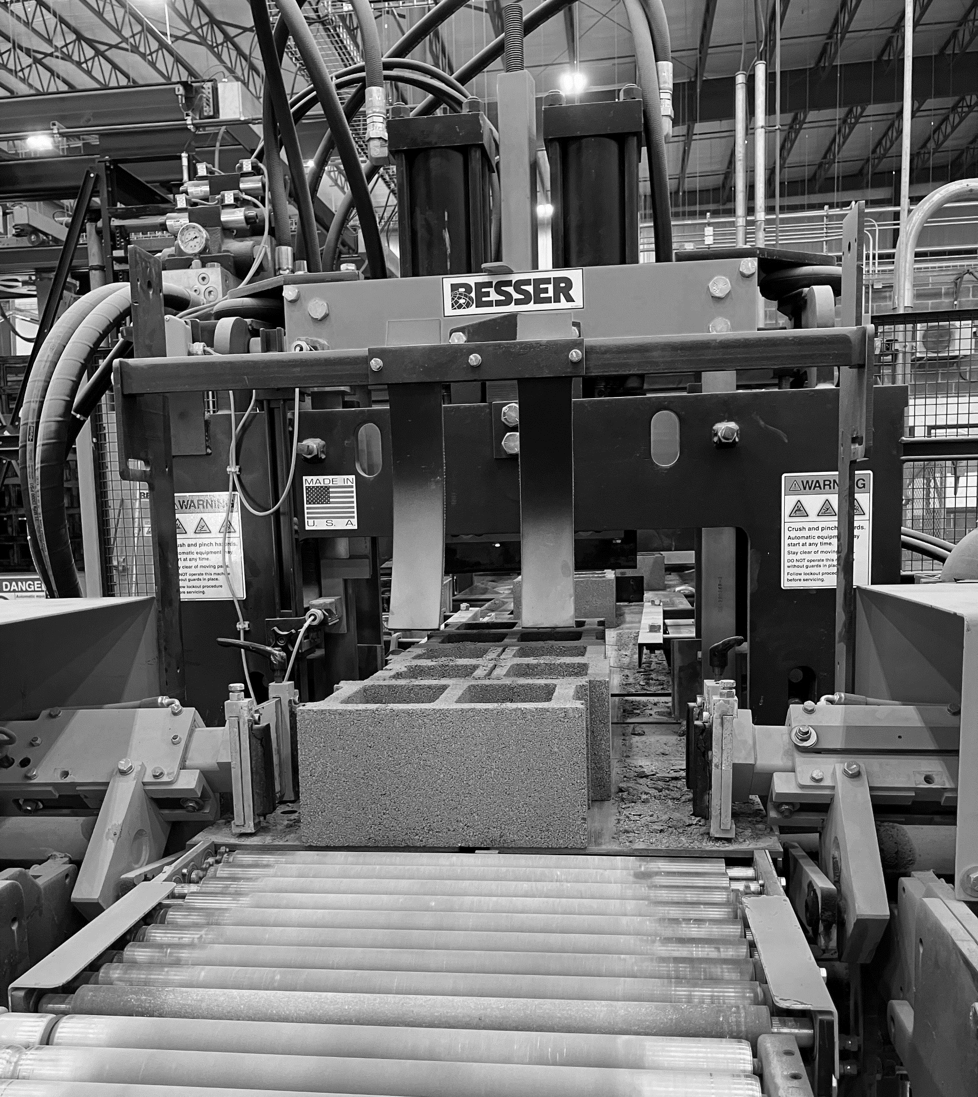
Assumptions and Prerequisite Skills
The machine is on
Supplies Needed
Standard PPE

Slide 3
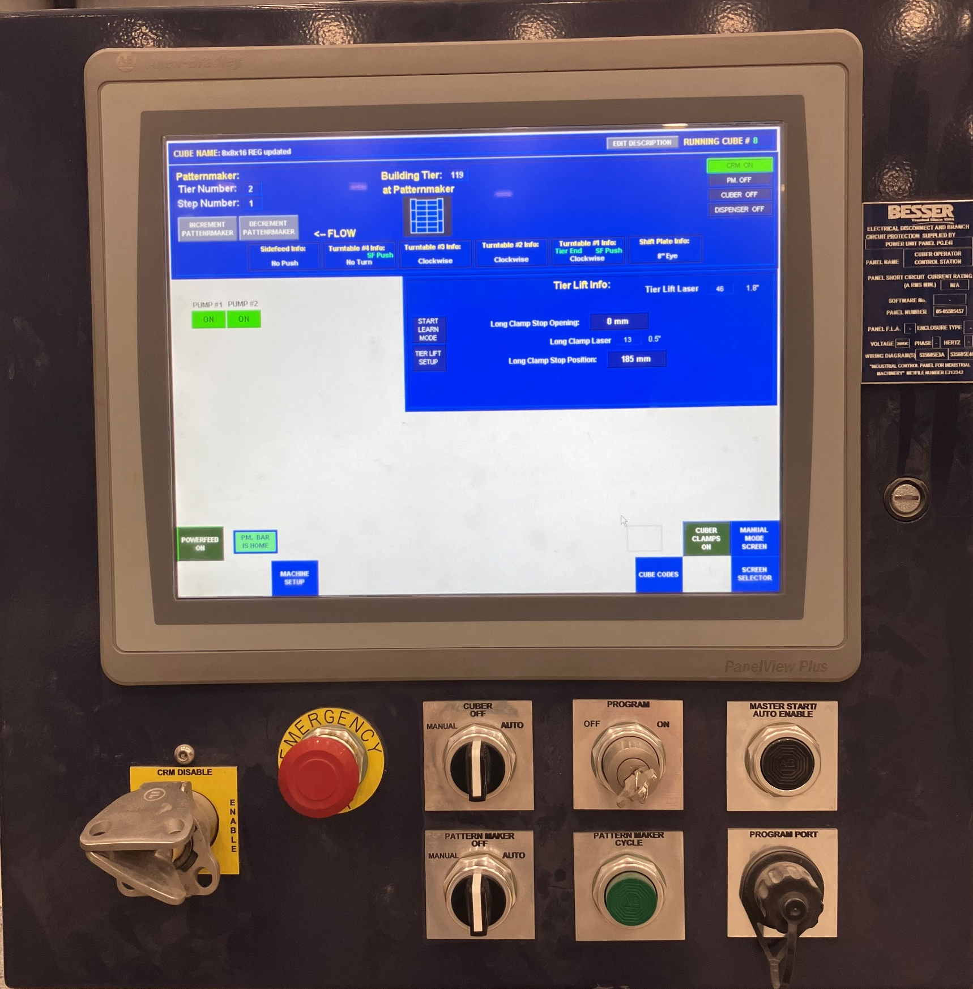
At the Cuber Panel, turn the “Cuber” and “Patternmaker” dials to off (Figure 1, red circles).
Push the Emergency stop in to turn of the air pumps (Figure 1, yellow arrow).
Figure 1

Slide 4
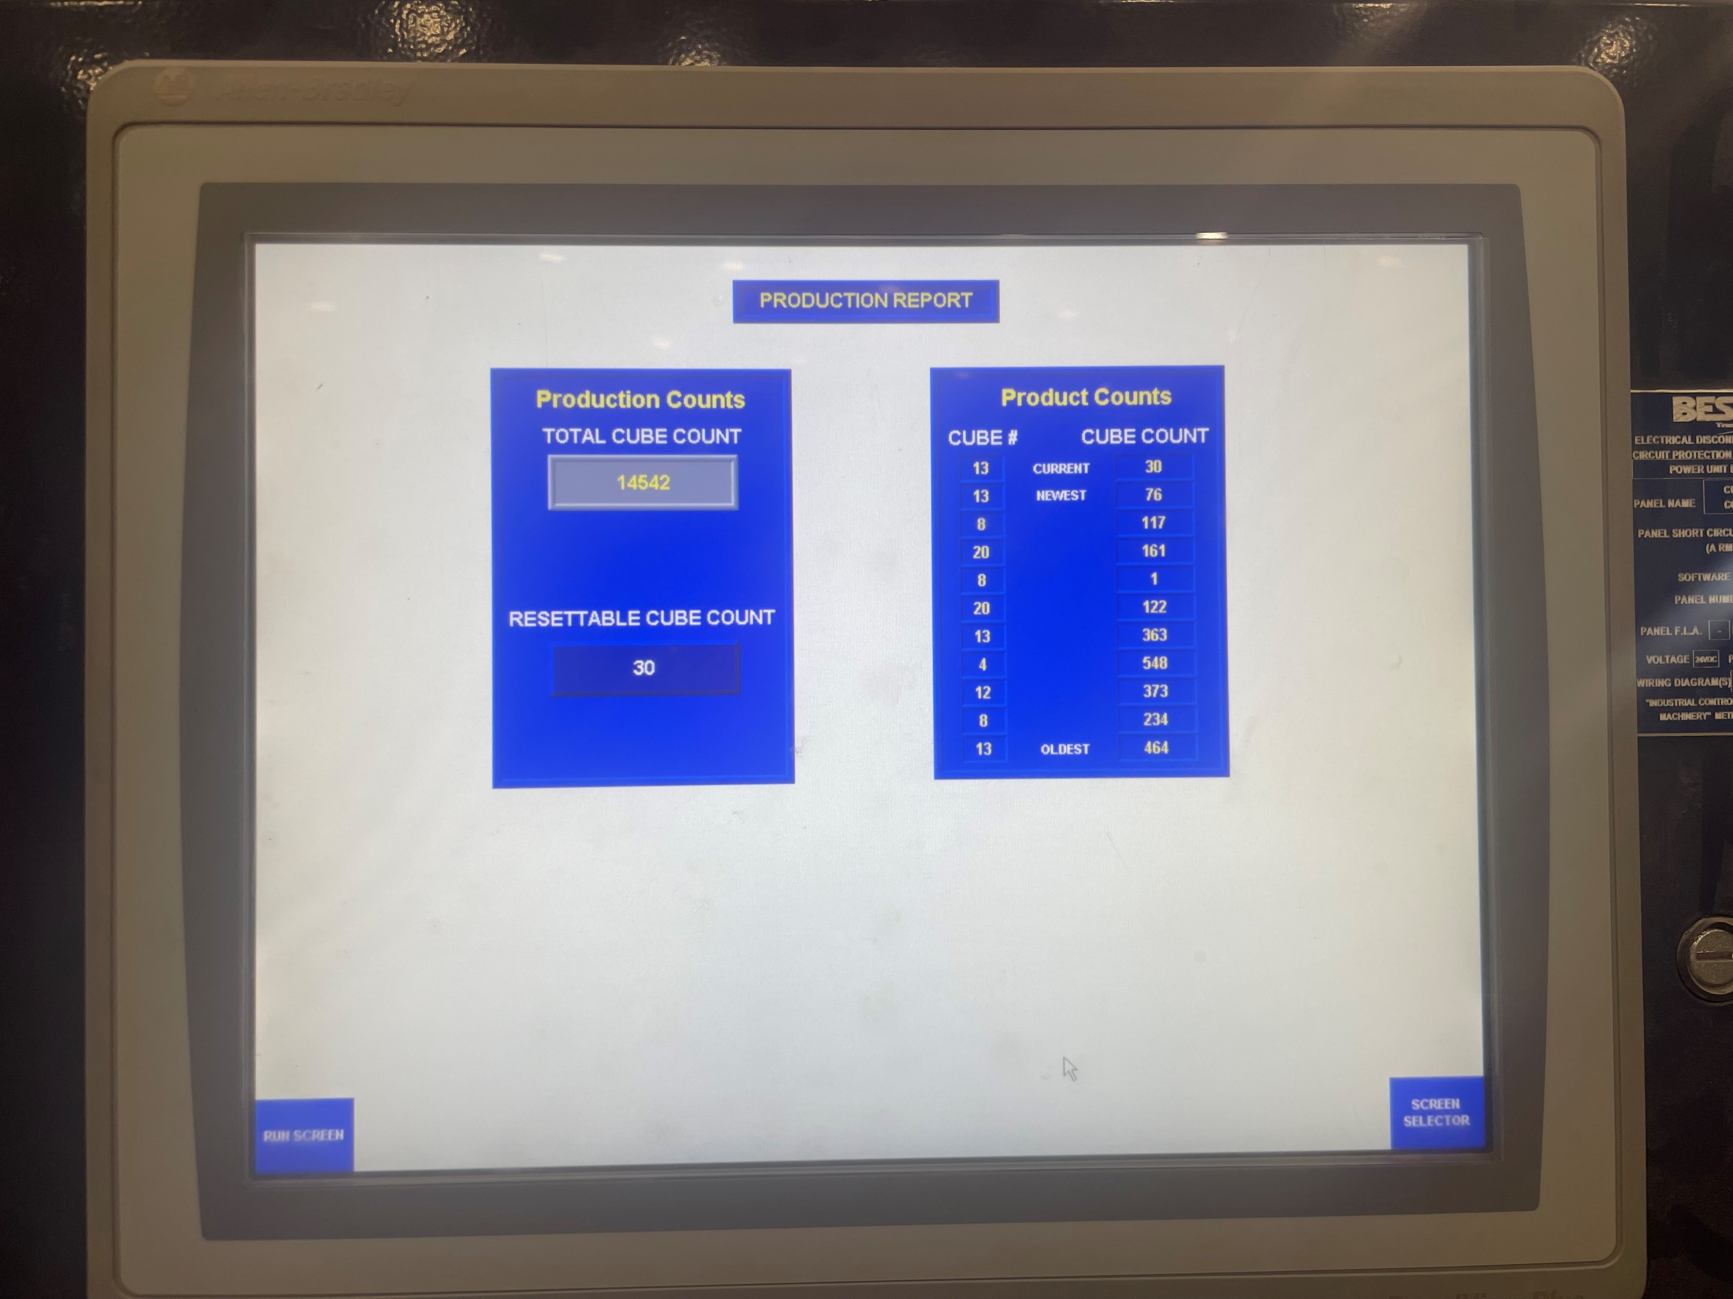
3. Select product report from the screen selector option to get the amount of cubes made. Record number on Cube Count Sheet. Clear “Resettable Cube Count” to 0 by selecting the box and putting in 0. This allows you to start correctly for the next shift.
Figure 2

Slide 5
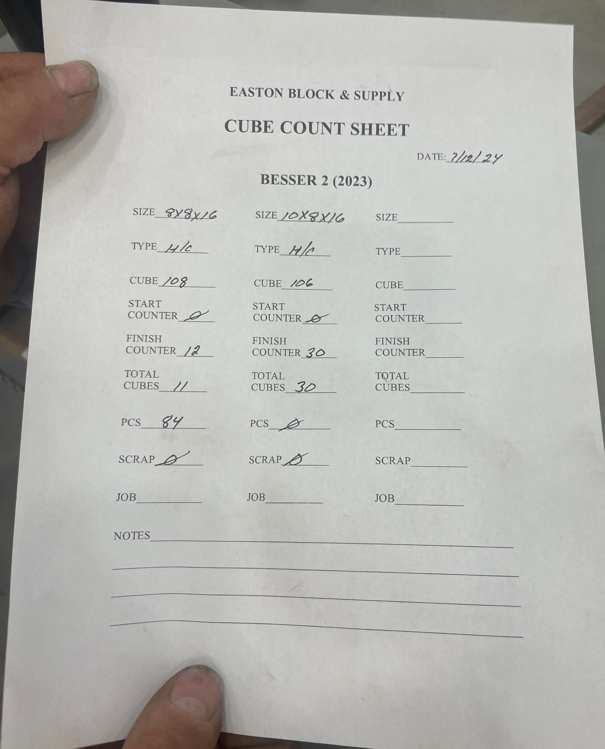
4. On the “Cube Count Sheet” write in the cubes that were finished on the “Finish Counter” line.
Make sure paperwork is properly filled out:
Date
Product
Size
Figure 3

Slide 6
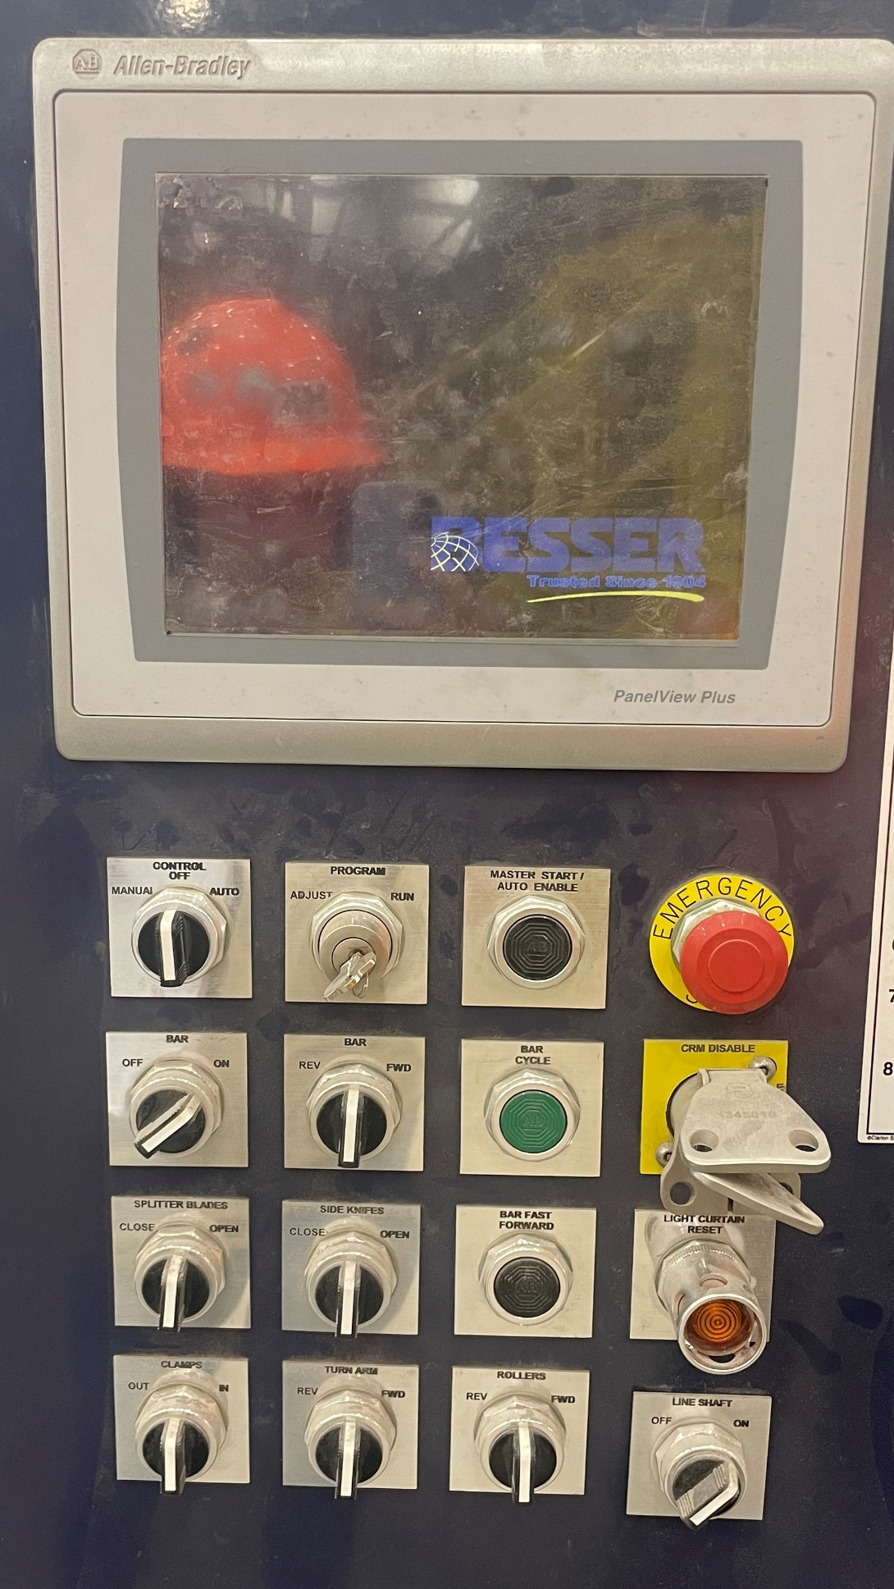
5. At the Splitter Panel, turn the “Control” dial to off and push in the emergency stop button (Figure 4).
Figure 4

Slide 7
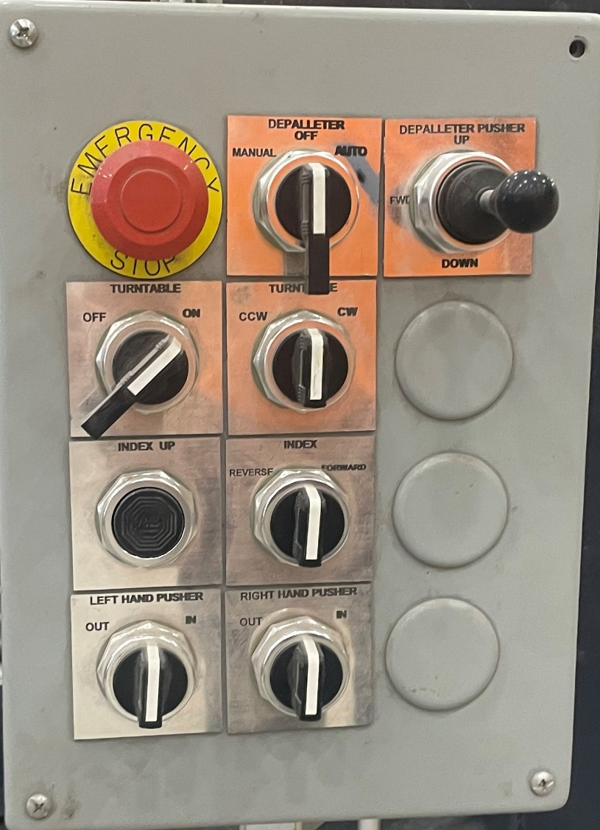
0
6. At the Depalleter Control Panel, Turn the “Depalleter” dial to off (red circle, figure 5).
Figure 5

Slide 8
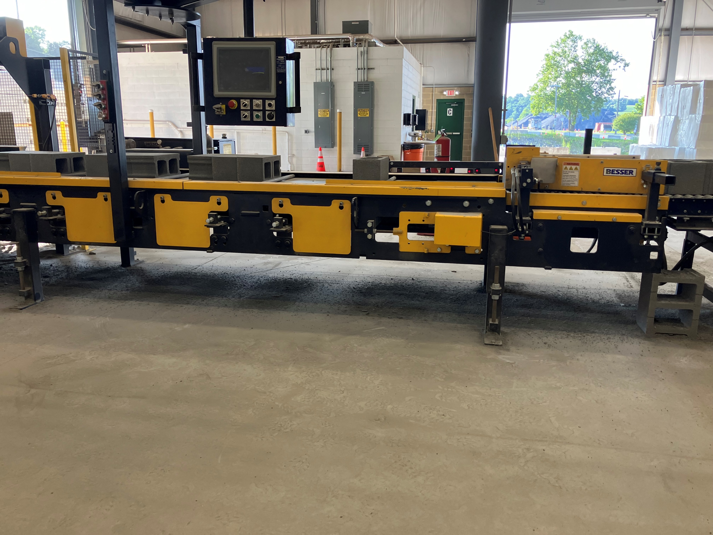
7. Make sure under conveyer is swept and tools are put away.
This completes the shut down process.
Figure 6

